Slide 1
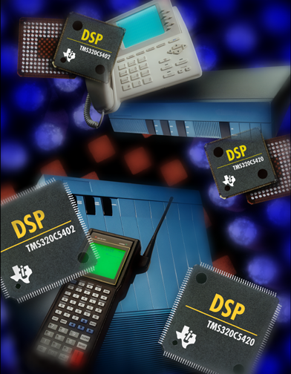
TMS320 One-Day DSP Workshop
For Arizona State University
Texas Instruments
C55x

Slide 2
Lab Day Agenda
Demo: Implement/Measure Power
Savings Methods
Lab One: Intro to 5510DSK and CCS
Using C Compiler, Optimizer, CSL

Slide 3
Agenda
Reducing Power Consumption
Using IDLE Modes
APM - Automatic Power Management
Modifying PLL Frequency
Increasing Performance
Internal vs. External Memory
Using a Dual-MAC
Application-Specific Instructions
VLI and Parallelism
Demo - Implement/Measure Power
Savings Methods

Slide 4
Demo - Power Savings Methods
Objectives
Modify PLL frequency using BIOS
Add BIOS IDL thread that executes C55x IDLE power down
Use GPIO0 pin to change voltage from 1.6V to 1.1V
Measure current draw (mA) at each step using Digital Multimeter
Time: 30min
Fill out the table:
C55x
DSP Clk/Volt CLKMD CPU Load Current
200MHz, 1.6V 0x2cd0
16MHz, 1.6V
16+IDLE, 1.6V
16+IDLE, 1.1V
CVdd
140mV
JP3
1Ω
1.6V
DMM
5510DSK
T TO
Note: JP3 measures only CVdd (DSP core + periphs, no I/O)
Technical Training
Organization
Notes:
Take a few moments to hook up the DMM, get it running with the Meter View software after explaining the objective of the lab. The students, at each step, will fill out the table on the slide. Remember, since we’re using a 1-ohm resistor and measuring mV, we are actually measuring mA. V=IR, so I = V/R where R is 1ohm, so I = V. The complete instructions for the demo are contained in the student guide.
The main goals of this lab are to show how to reduce the frequency of the CPU using the cdb file and programming the CLKMD register and using idle domains in the BIOS IDL loop to power down the device when nothing else is going on.
During the last build, we will use the GPIO0 pin to change the voltage to 1.1V.

Slide 5
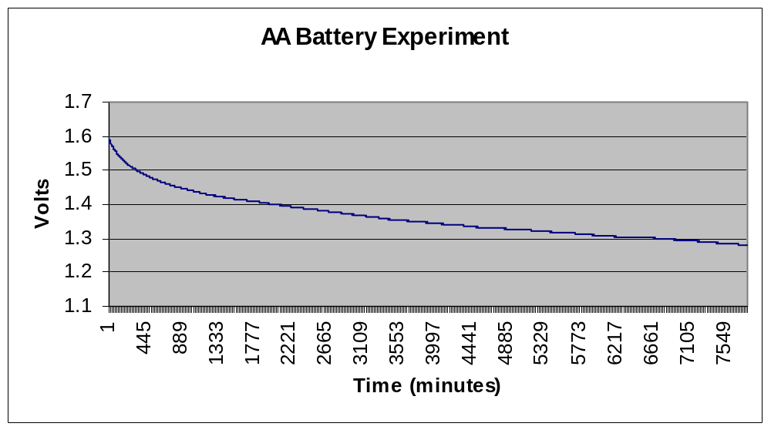
Power Experiment
The C55x is currently characterized at 1.6V (nominal). Soon, it
will be characterized down to approximately 1.0V.
How long does a single AA battery last when running our app
at 16MHz, 1.6V, CPU IDLEd ?
During last 1000min, current draw = -18µA/min
Probable time to reach 1.1V from start = 297 hours = 12.4 days
AA batteries usually exhibit a voltage dropoff at ~0.9V
T TO
Technical Training
Organization
Notes:
This is a real, empirical test of the C55x running an application on a single AA battery. You can look at power curves of AA batteries, figure out how much power your application draws and then determine how long a AA battery will last. However, it’s better to TEST IT. That’s what we did.
This is just FYI information for the students…and the facts speak for themselves. Their application will be different…but the assumptions and conditions of the test are shown.

Slide 6
Debrief
What are the benefits of reducing power?
How do you modify the PLL frequency?
Is this a static or dynamic setting?
What is the difference between APM and IDLE?
Is it possible to dynamically scale frequency and
voltage within your application?
“Ideally, you want to scale frequency and
voltage to match the algorithm’s requirements.”
New Power Tools Planned (1H03):
Power Analyzer (provides energy used in each function) - NOW
PSL - Pwr Scaling Lib (dynamic scaling for non-BIOS apps) - NOW
BIOS PWR Module (dynamic freq/volt scaling for BIOS apps) - 4Q03
T TO
Refer to PSL app note (SPRA848) for dynamic volt/freq scaling
Technical Training
Organization
Notes:
The Power Analyzer is available today (Feb 03), however you need an oscilloscope and a plug in board to the PC to use it. TI is working on a power capture board to make this process easier. The BIOS PWR module will allow you to easily scale freq/voltage per function in your application. It is currently in alpha release (Feb 03) and is expected to be widely available in summer 2003. It does require you to hook XF pin to the voltage regulator in your system.
Benefits of reducing power? Lower EMI, longer battery life, runs cooler, extends life of system
How do you modify the PLL frequency? Use the cdb -->Global Settings…and change BOTH the frequency (for BIOS) and CLKMD setting (for the CPU)
Using the cdb file is a static setting
APM is automatic power management and turns the clocks off to unused resources. This does NOT turn off the power to the resource. IDLE shuts off power and clocks to the resource depending on the mode you’ve chosen.

Slide 7
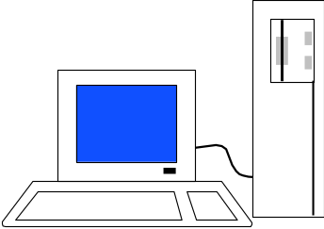
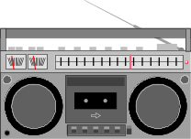
Lab - Intro to 5510DSK and CCS
Objectives
Set up 5510DSK and run diagnostics
Perform basic CCS operations (build, load, run, etc.)
Investigate the operation of the audio application (software
flow, DIP switches, system setup)
Create and use real-time profiling and other RTA tools
Time: 60min
AIC23
McBSP2
DMA
inBuffer
ADC
REVT
Ping
midi
DRR
Pong
Copy/Filter
outBuffer
DXR
Ping
Pong
DAC
XEVT
DMA
T TO
Technical Training
Organization
Notes:
The first lab is getting the student’s feet wet with CCS, RTA, the DSK and the audio application. Spend a few moments going thru the flow again of the audio data. One of the “cool” parts of the lab is that the students actually get to use real-time profiling (BIOS statistics) in the lab - they program it and use it themselves.

Slide 8
Debrief
What problems did you encounter?
Did any step/action confuse you?
What is the purpose of the .cdb file?
What is the user linker command file used for?
Explain how the audio application works.
What was the benchmark for fir2.asm?
T TO
Technical Training
Organization
Notes:
This is a monitoring tool and you may need to shift gears/emphasis based on answers to these questions. If there is anything that is a major problem/issue, WRITE IT DOWN and follow up on it later or immediately.

Slide 9
Agenda
Peripherals - the I/O Gateway
McBSP, Codec
DMA
Using CSL to Program Peripherals
C55x C Compiler Performance
Using DSP/BIOS
BIOS Thread Types
Real-time Analysis Tools
Lab - Using C Compiler/Optimizer, CSL

Slide 10
Lab - Using C Compiler, Optimizer, CSL
Objectives
Use C compiler/optimizer to achieve highly optimized ASM
code from a C fir function
Investigate how CSL is used to set up/manage peripherals
Understand BIOS threads and how they are used in the
audio application
Optional - Create a Standalone System (burn the FLASH)
Time: 60min
AIC23
McBSP2
DMA
inBuffer
ADC
REVT
Ping
midi
DRR
Pong
Copy/Filter
outBuffer
DXR
Ping
Pong
DAC
XEVT
DMA
T TO
Technical Training
Organization

Slide 11
Debrief
What problems did you encounter?
Did any step/action confuse you?
What is the purpose of the Build Options?
Explain “Build Configurations”?
Explain the 2-step process to set up a
peripheral using CSL.
Explain the difference between HWI vs. SWI.
What is a periodic function and how do you set it up?
What was your final benchmark for cfir?
Did anyone try the optional lab? Comments?
T TO
Technical Training
Organization
Notes:
Build Options is the central place in CCS where you specify the options for the compiler and linker - the items that affect the build process.
CSL - two steps - (1) set up the options in the configuration; (2) apply the config to a resource
HWI is a hardware interrupt on the processor and is triggered by a peripheral, external interrupt, etc. An ISR is usually run to service the interrupt. HWIs are “scheduled” by the user via the IER (interrupt enable register). An SWI is triggered by software (usually within an HWI) and is scheduled by the BIOS Scheduler based on other priorities in the system.
A periodic function runs every “x ticks” based on the CPU’s timer. You set it up by going to the Periodic Function Mgr, inserting a new function, telling it how often to run and which function to run in the code.
Cfir should have been around 116K cycles. The “optional” part of the lab allows the students to burn their code into FLASH. It’s really a simple process…but they might have some comments/issues.

